Slide 1

NLP for iTunes Reviews of Politics/News-oriented NPR Podcasts
Chris Castano

Slide 2
Background:
Briefly worked at NPR
Enjoy working with audio
NPR’s new emphasis on digital strategy
Lack of understanding of the digital space
Recently posted a job in podcast strategy

Slide 3
Guiding Questions:
Didn’t analyze music or culture podcasts. Those are easy sells. News and politics are harder to find an audience for.
For these podcast reviews:
What are people writing in their reviews?
How do they rate based on what they write?
What are people writing in the most negative reviews?
When are reviews being posted?
In what years are reviews more or less positive?

Slide 4
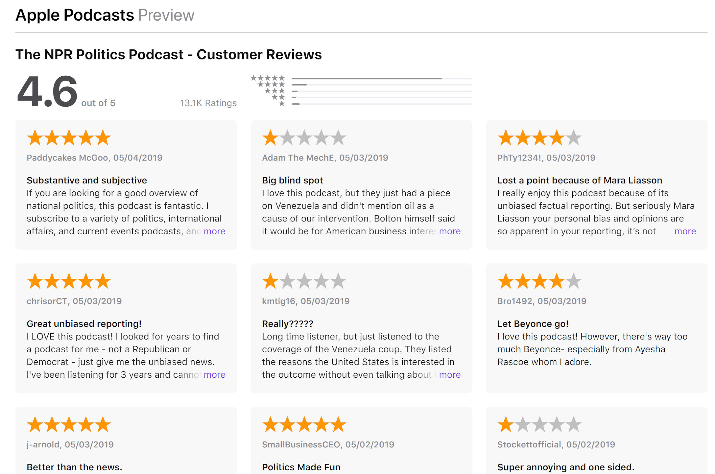
Podcasts are tricky to market
iTunes doesn’t show plays
Very little info shown, even to show creators
Advertising for Podcasts based off of reviews

Slide 5
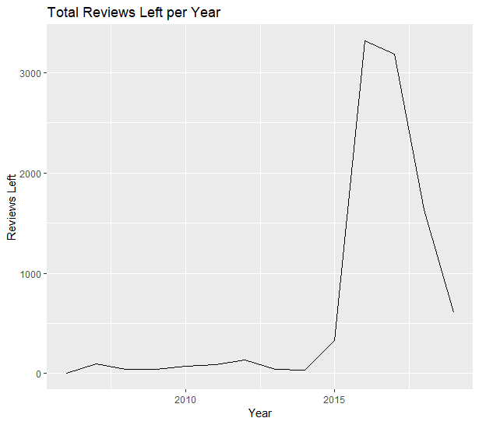
Year | Reviews Left
2006 6
2007 98
2008 45
2009 44
2010 74
2011 85
2012 134
2013 45
2014 34
2015 326
2016 3314
2017 3185
2018 1637
2019 607

Slide 6

What gives?
2016 election starts up
Several major podcasts are founded/production picks up
The advent of “Serial” in 2014

Slide 7
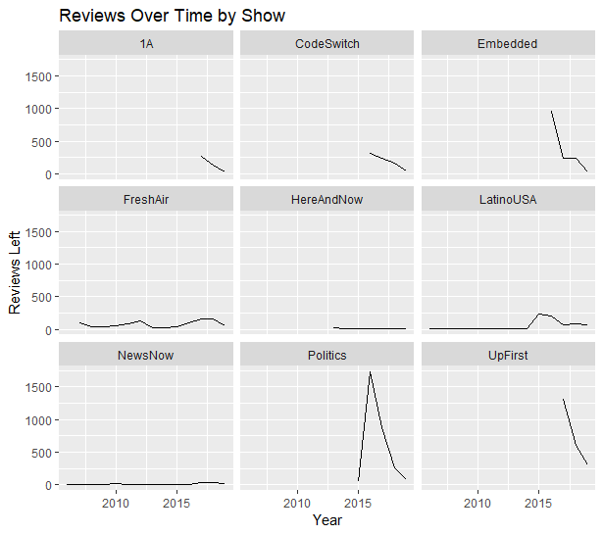

Slide 8
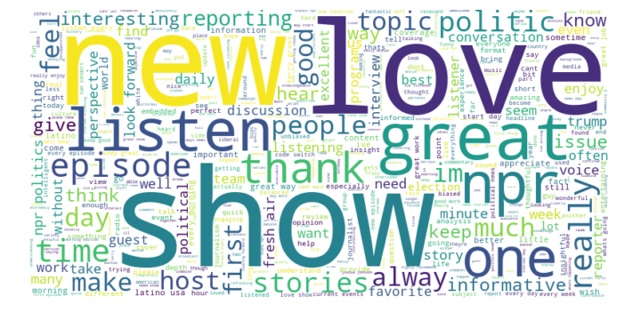
World cloud - Total

Slide 9
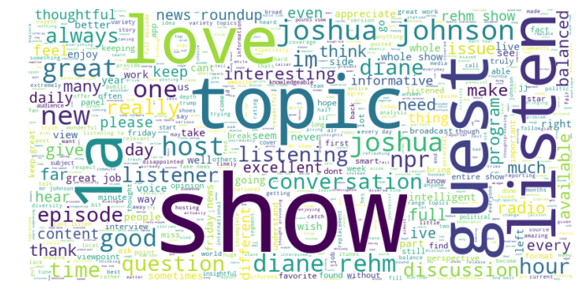
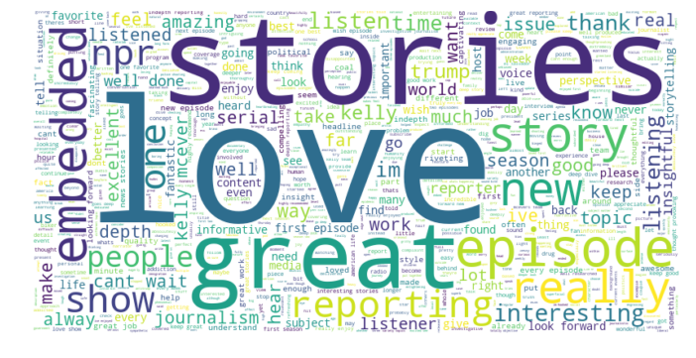
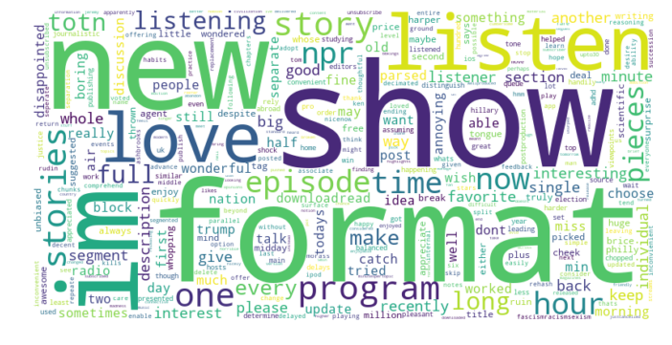
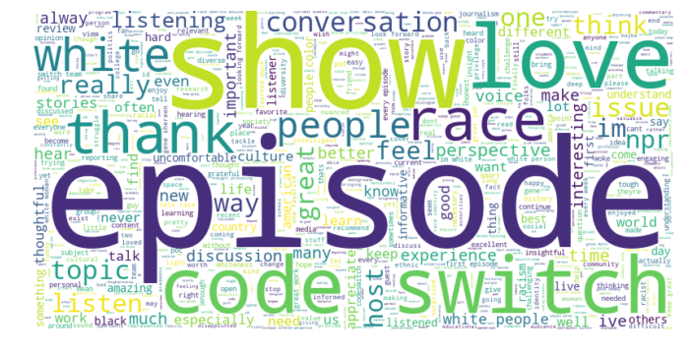
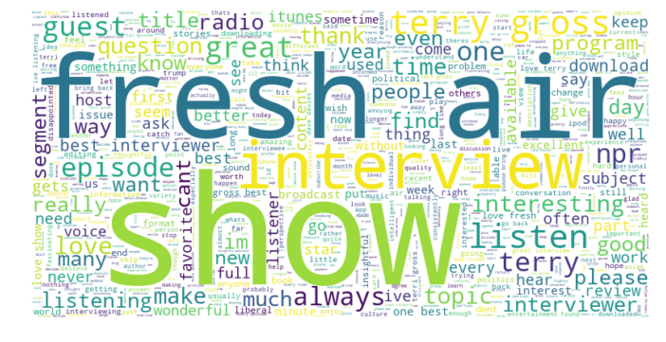
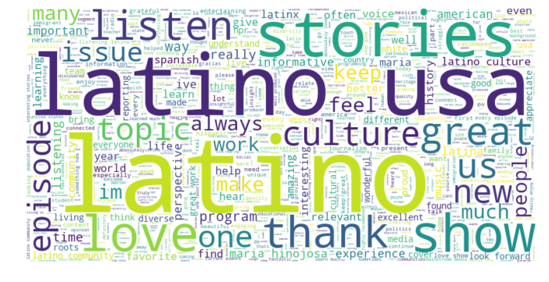
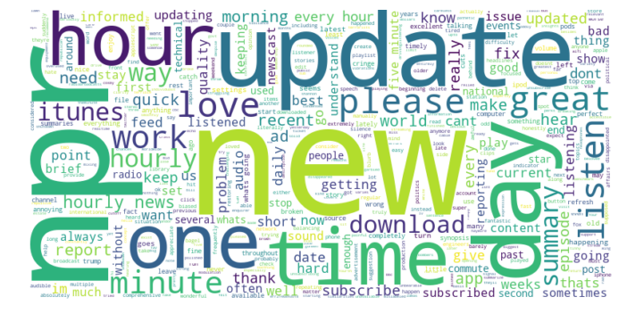
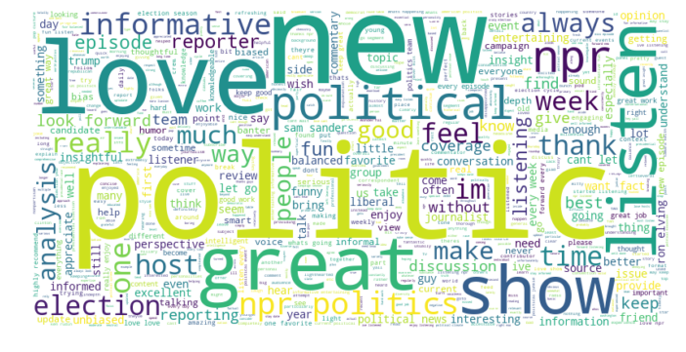
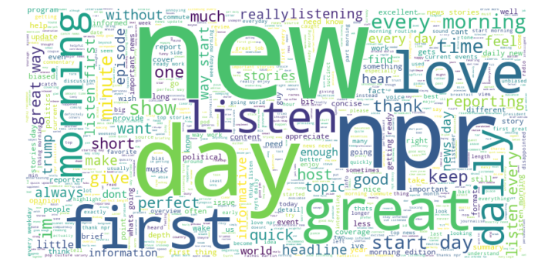
1A
Embedded
Here And Now
Code Switch
Fresh Air
Latino USA
News Now
NPR Politics
Up First

Slide 10
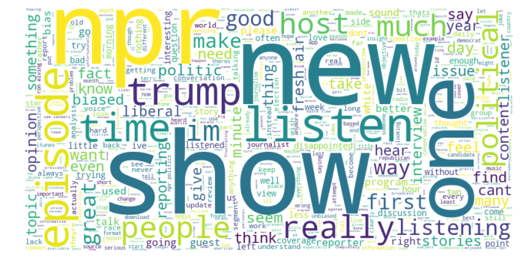
World cloud - 1 Star

Slide 11
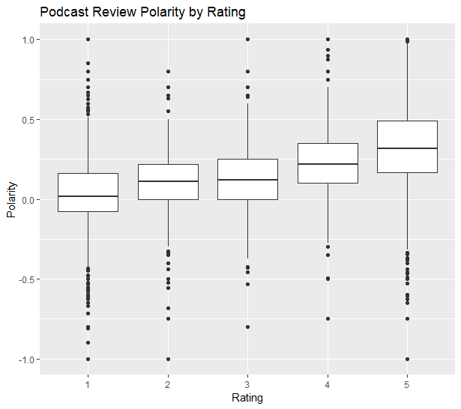
5 Star: 7,295
4 Star: 638
3 Star: 424
2 Star: 412
1 Star: 865

Slide 12
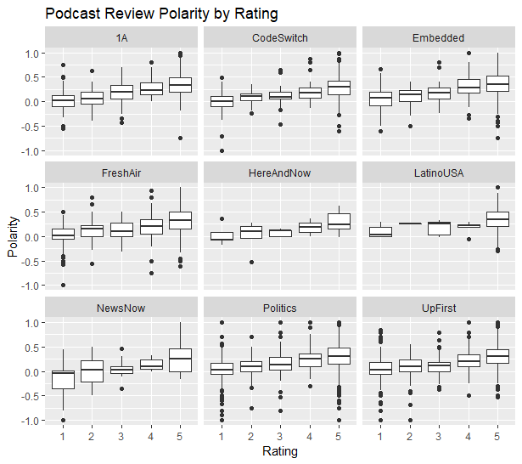

Slide 13
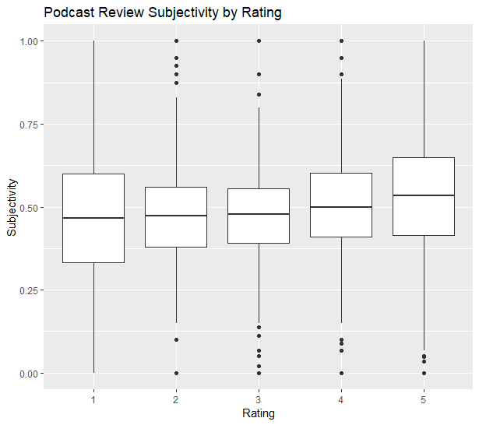
5 Star: 7,295
4 Star: 638
3 Star: 424
2 Star: 412
1 Star: 865

Slide 14
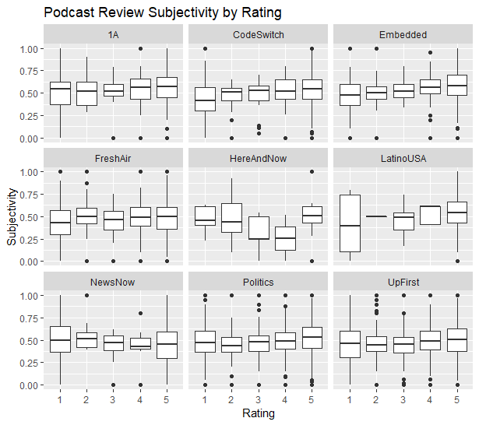

Slide 15
Informed Takeaways:
In the Future:
NPR audience is extremely loyal
Many individual word clouds contain host names
“Conversation”, “discussion”, “stories”, “listening”
Overall very few negative reviews
Negative reviews tend to reference perceived bias
Some one-star reviews are about technical issues, not overly negative
NLP with Machine Learning
Do this again when there are more lower-rated reviews
Compare Reviews with Specific Podcast Episodes released around the same time

